Slide 1
Tuesday, 12 March 2024
Raising Achievement Evening

Slide 2
Tuesday, 12 March 2024
History OCR B
The Schools History Project

Slide 3
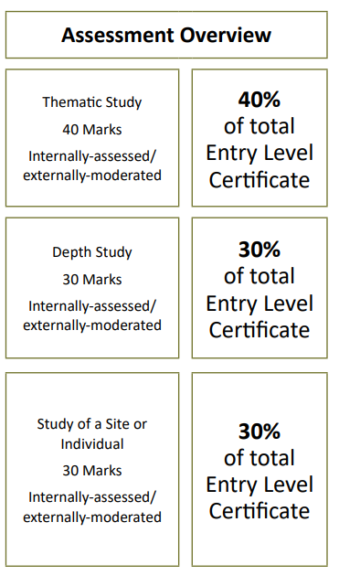
Tuesday, 12 March 2024
Entry Level Certificate 1-3
Internal Assessment
Externally Moderated
Deadline 20th April
2025
Crime and Punishment c.1250 to present day
Assessment Paper
The Norman Conquest 1065-1087 or The Viking Age c.750-1050
Assessment Paper
Leeds or Dover Castle
Independent research and PPT

Slide 4
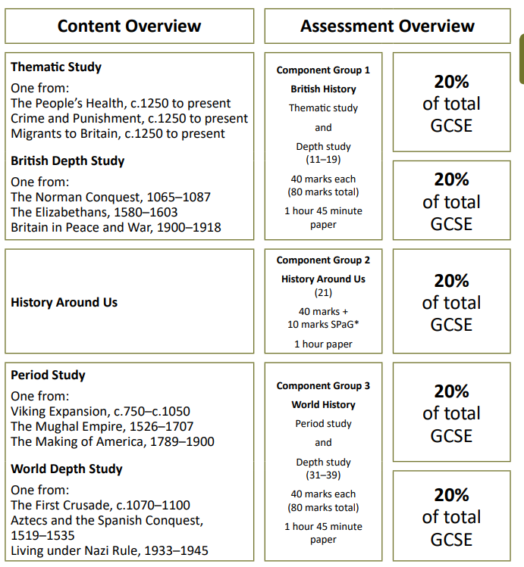
Tuesday, 12 March 2024
GCSE 9-1
Provisional Examination Dates 2025
16th May 2025 Morning
History Around Us ( 1 hour )
5th June 2025 Afternoon
Crime and Punishment c.1250 to present & The Norman Conquest, 1065-1087 ( 1 hour 45 minute )
10th June 2025 Afternoon
Viking Expansion, c.750-c.1050 & Living under Nazi Rule, 1933-1945 ( 1 hour 45 minute)

Slide 5
Tuesday, 12 March 2024
Revision Guides
Kerboodle Website www.kerboodle.com
Virtual textbook, assessments for each chapter of learning.
Revision Guides and Practice
£11.50

Slide 7
Tuesday, 12 March 2024
Raising Achievement Afternoon: GCSE Mathematics
Exam Dates (all papers 1h30):
GCSE Maths Paper 1 (Non-Calculator) – Thursday 16th May 2025
GCSE Maths Paper 2 (Calculator) – Wednesday 4th June 2025
GCSE Maths Paper 3 (Calculator) – Wednesday 11th June 2025

Slide 8
Tuesday, 12 March 2024
Raising Achievement Afternoon: GCSE Mathematics
Number:
Basic Number
Basic Fractions
Basic Decimals
Basic Percentages
Calculating with percentages
Factors and Multiples
Indices
Rounding
Standard Form
Algebra
Basic algebra
Algebra and graphs
Quadratics, Rearranging and Identities
Coordinates and Linear graphs
Equations
Inequalities
Quadratic graphs
Real Life Graphs
Sequences
Simultaneous Equations
Sketching Graphs
Solving quadratic graphs
Geometry and Measure
Angles
Circumference and Area
Congruence and Similarity
Constructions and Loci
Measures
Perimeter and Area
Properties of Polygons
Pythagoras’ Theorem
Scale Diagrams And Bearings
Transformations
Trigonometry
Vectors
Volume
2D representations of 3D shapes
Probability
Using Tables and Frequency Trees
Probability of Events
Expected Frequencies
Probability Scales
Exhaustive and Exclusive events
Venn Diagrams
Ratio and Proportion
Calculating with percentages
Direct and Inverse Proportion
Growth and Decay
Ratio and Proportion
Statistics
Collecting and Representing Data
Scatter Graphs
Statistical Measure

Slide 9
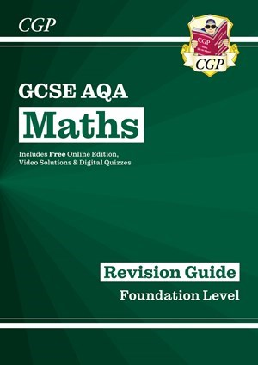
Tuesday, 12 March 2024
Raising Achievement Afternoon: GCSE Mathematics
Revision Guides/Resources:
CGP GCSE AQA Maths Foundation Revision Guide £6.50
Pearson AQA GCSE 9-1 Foundation Revision Guide £5.90
www.MyMaths.co.uk - School Log in: hopeview
School p/w: square8
GCSE Maths - AQA - BBC Bitesize
Maths Genie • Learn GCSE Maths for Free
Mr Barton Maths
GCSE Maths Revision | Past Papers | Worksheets | Online Tests (mmerevise.co.uk)
PREDICTED PAPERS | 1st Class Maths
Math | Khan Academy

Slide 10
Tuesday, 12 March 2024
Raising Achievement Afternoon: Functional Skills Mathematics
Exam Dates:
Functional Skills Maths Paper 1 (Non-Calculator – 30min) – Tuesday 7th January 2025 PM/ Tuesday 13th May 2025
Functional Skills Maths Paper 2 (Calculator - 1h30) – Tuesday 7th January 2025 PM/ Tuesday 13th May 2025

Slide 11
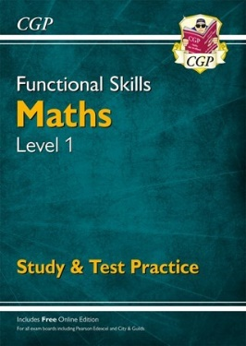
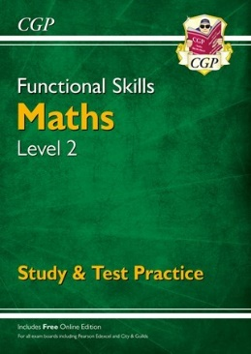
Tuesday, 12 March 2024
Raising Achievement Afternoon: Functional Skills Mathematics
Revision Guides/Resources:
CGP Functional Skills Maths Level 1 Revision Guide £8
CGP Functional Skills Maths Level 2 Revision Guide £8
www.MyMaths.co.uk - School Log in: hopeview
School p/w: square8
GCSE Maths - AQA - BBC Bitesize
Maths Genie • Learn GCSE Maths for Free
Mr Barton Maths
GCSE Maths Revision | Past Papers | Worksheets | Online Tests (mmerevise.co.uk)
PREDICTED PAPERS | 1st Class Maths
Math | Khan Academy

Slide 12
Tuesday, 12 March 2024
Raising Achievement Afternoon: Functional Skills Mathematics
Use of number and the number system
Read, write, order and compare large numbers (up to one million)
Recognise and use positive and negative numbers
Multiply and divide whole numbers and decimals by 10, 100, 1000
Use multiplication facts and make connections with division facts
Use simple formulae expressed in words for one or two-step operations
Calculate the squares of one-digit and two-digit numbers
Follow the order of precedence of operators
Read, write, order and compare common fractions and mixed numbers
Find fractions of whole number quantities or measurements
Use of number and the number system
Read, write, order and compare decimals up to three decimal places
Add, subtract, multiply and divide decimals up to two decimal place
Approximate by rounding to a whole number or to one or two decimal places
Read, write, order and compare percentages in whole numbers
Calculate percentages of quantities, including simple percentage increases and decreases by 5% and multiples thereof
Estimate answers to calculations using fractions and decimals
Recognise and calculate equivalences between common fractions, percentages and decimals
Work with simple ratio and direct proportions

Slide 13
Tuesday, 12 March 2024
Raising Achievement Afternoon: Functional Skills Mathematics
Use of measures, shape and space
Calculate simple interest in multiples of 5% on amounts of money
Calculate discounts in multiples of 5% on amounts of money
Convert between units of length, weight, capacity, money and time, in the same system
Recognise and make use of simple scales on maps and drawings
Calculate the area and perimeter of simple shapes including those that are made up of a combination of rectangles
Calculate the volumes of cubes and cuboids
Draw 2-D shapes and demonstrate an understanding of line symmetry and knowledge of the relative size of angles
Interpret plans, elevations and nets of simple 3-D shapes
Use angles when describing position and direction, and measure angles in degrees
Handling information and data
Represent discrete data in tables, diagrams and charts including pie charts, bar charts and line graphs
Group discrete data and represent grouped data graphically
Find the mean and range of a set of quantities
Understand probability on a scale from 0 (impossible) to 1 (certain) and use probabilities to compare the likelihood of events
Use equally likely outcomes to find the probabilities of simple events and express them as fractions

Slide 14
Raising Achievement
English

Slide 15
Functional Skills Level 1 & 2
Paper 1-Reading 33.3%
1 hour, 26 marks
Pass Mark (average)
Level 1- 15/30
Level 2- 17/30
Paper 2- Writing 33.3%
1 hour, 30 marks
Pass Mark (average)
Level 1: 16/30
Level 2: 18/30
NEA: Speaking, Listening & Communication 33.3%
Non-Exam Assessment (Pass or Fail)
Presentations completed in class
Exam Dates
Thursday 16th May 2024 (Level 1 & 2 Paper 1 and 2)
Speaking & Listening- to be completed in lesson this term for both levels
Functional Skills is a Pass or Fail qualification.
A pass at Level 2 is equivalent to a GCSE 4

Slide 16
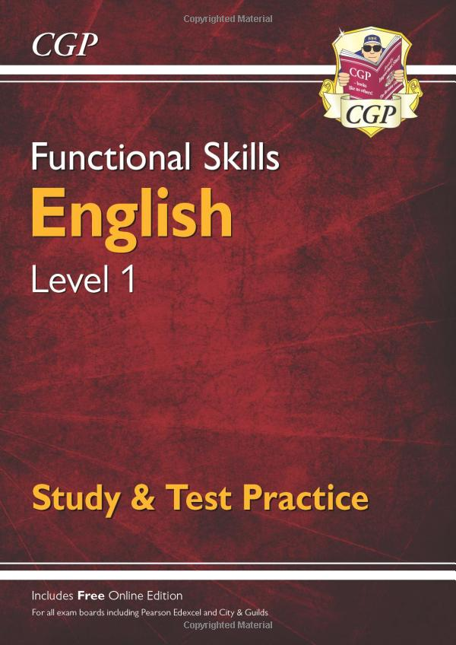
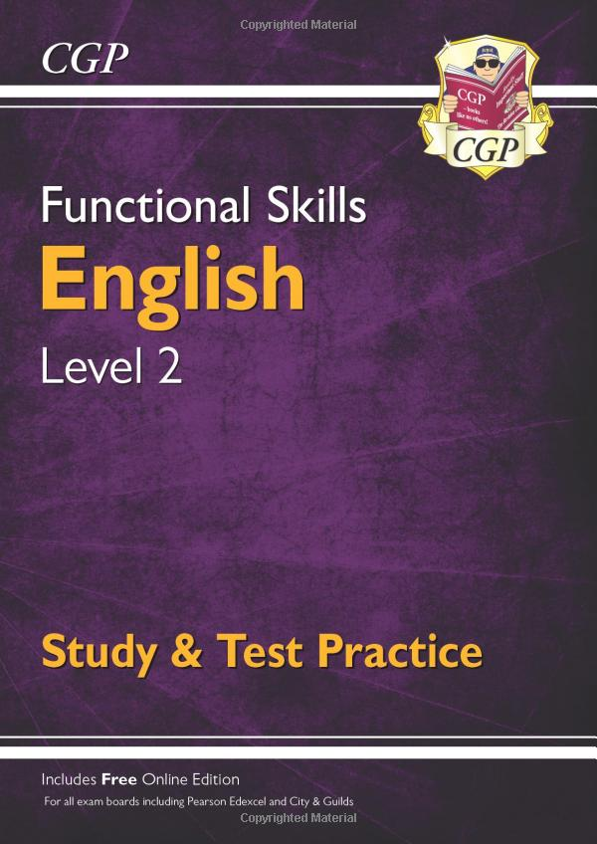
Revision Resources

Slide 17
GCSE Language
Paper 1
Explorations in Creative Reading & Writing
1hr 45 mins- 80 marks
Section A - 4 questions (quality of reading)- 40 marks
1- Multiple choice/ true of false 4 marks
2- Language analysis 8 marks
3- Structure 8 marks
4- To what extent 20 marks
Section B- 1 question - 40 marks
Pupils will be asked to write either a description or a narrative based on an image/ statement
Paper 2
Writer’s Viewpoints & Perspectives
1hr 45 mins - 80 marks
Section A- 4 questions- 40 marks
1- Multiple choice/ true of false- 4 marks
2- similarities and differences between two sources - 8 marks
3- Language analysis of one source- 12 marks
4- Compare the viewpoints of the writers, referring to both sources- 16 marks
Section B - 1 question - 40 marks
Extended writing task- non-fiction
24 marks- content & organisation
16 marks- technical accuracy (SPaG)
NEA Speaking & Listening
To be completed in class during lessons.
A presentation based on controversial topics or real life issues.

Slide 18
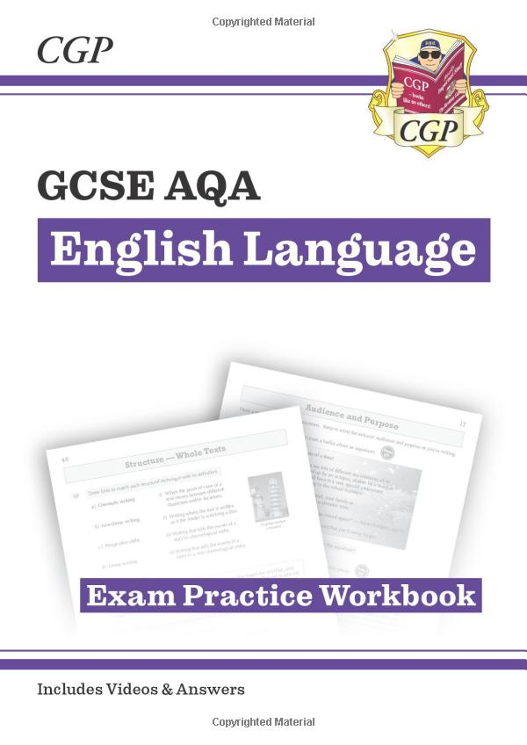
Revision Resources

Slide 19
English Exams 2024/5 | Date
Functional Skills Level 1 & 2- 2024 | Thursday 16th May 2024
Functional Skills Level 1 & 2- 2025 | 8th Jan 2025/ 26th Feb 2025
English Language Paper 1 – GCSE | 23rd May 2025
English Language Paper 2 - GCSE | 6th June 2025
Speaking & Listening Component | Marked in class before formal exams start!

Slide 20
Any questions?

Slide 21
Raising Achievement in Science
2024
Tuesday, 12 March 2024
Science GCSE and ELC 2025
Content assessed in the exams and exams
Exam board
Length of exams
Dates of exams this year for relevant pupils
Best revision guides and ways to revise you subject

Slide 22
Raising Achievement in Science
2024
Tuesday, 12 March 2024
1. Exam board: AQA – GCSE Combined Science Synergy;
- Entry Level Certificate Level 1 or 2.
2.Content assessed in the exams and exam board:
Subject content for GCSE:
Biology, Chemistry and Physics- 4 exams in total:
Paper 1 – 2 exams
Paper 2 – 2 exams
1. Building blocks
2. Transport over larger distances
3. Interactions with the environment
4. Explaining change
5. Building blocks for understanding
6. Interactions over small and large distances
7. Movement and interactions
8. Guiding Spaceship Earth towards a sustainable future
9. Key ideas
At HVS, to make sure all the content is covered in Science, students have AQA Checklists that are used during lessons to check their progress.
Subject content for Entry Level Certificate (ELC)
It is considered being a Level 3 or equivalent of a Grade 3 in Science.
Biology, Chemistry and Physics
Single Award = 3 components
Students studying Entry Level Science – Single Award need only submit evidence for three Teacher-devised assignments plus three externally-set assignments. These do not need to be from the same components.
Double Award = 6 components
Students studying Entry Level Certificate Science – Double Award must submit evidence for six Teacher-devised assignments plus six Externally-set assignments.
Guided learning hours: 120
Total qualification time: 120

Slide 23
Raising Achievement in Science
2024
Tuesday, 12 March 2024
1. Exam content- 4 papers
Paper 1
What's assessed Life and environmental sciences Topics 4.1–4.4: Building blocks; Transport over larger distances; Interactions with the environment and Explaining change.
How it's assessed Written exam: 1 hour 45 minutes Foundation or Higher Tier 100 marks 25% of GCSE
Questions Multiple choice, structured, closed and open short answer questions, with greater emphasis on knowledge and application (AO1 and AO2) than analysis and evaluation (AO3).
Paper 2
What's assessed Life and environmental sciences Topics 4.1–4.4: Building blocks; Transport over larger distances; Interactions with the environment and Explaining change.
How it's assessed Written exam: 1 hour 45 minutes Foundation and Higher Tier 100 marks 25% of GCSE
Questions Multiple choice, structured, closed and open short answer questions. This paper assesses most of the analysis and evaluation (AO3) skills, and most of the work on the required practicals, for the topics.

Slide 24
Raising Achievement in Science
2024
Tuesday, 12 March 2024
1. Exam content- 4 papers
Paper 3
What's assessed Physical sciences Topics 4.5–4.8: Building blocks for understanding; Interactions over small and large distances; Movement and interactions and Guiding Spaceship Earth towards a sustainable future.
How it's assessed Written exam: 1 hour 45 minutes Foundation and Higher Tier 100 marks 25% of GCSE
Questions Multiple choice, structured, closed and open short answer questions, with greater emphasis on knowledge and application (AO1 and AO2) than analysis and evaluation (AO3).
Paper 4
What's assessed Physical sciences Topics 4.5–4.8: Building blocks for understanding; Interactions over small and large distances; Movement and interactions and Guiding Spaceship Earth towards a sustainable future.
How it's assessed Written exam: 1 hour 45 minutes Foundation and Higher Tier 100 marks 25% of GCSE
Questions Multiple choice, structured, closed and open short answer questions. This paper assesses most of the analysis and evaluation (AO3) skills, and most of the work on the required practicals, for the topics.

Slide 25
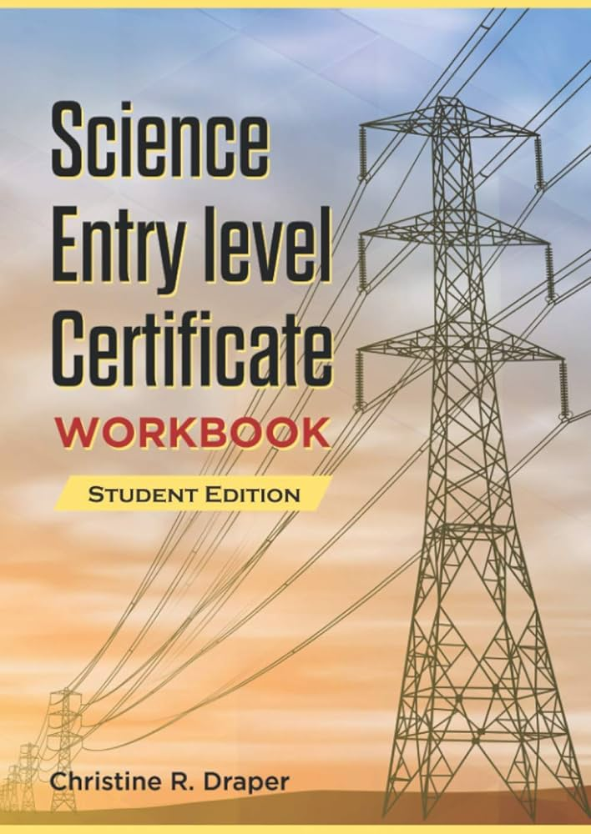
Raising Achievement in Science
2024
Tuesday, 12 March 2024
1. Exam content- ELC Level 1 & 2
Level 1 – 3 components
Level 2- all 6 components
Biology
1. Component 1- Biology: The human body
2. Component 2 - Biology: Environment, evolution and inheritance
Chemistry
3. Component 3 - Chemistry: Elements, mixtures and compounds
4. Component 4 - Chemistry: Chemistry in our world
Physics
5. Component 5 - Physics: Energy, forces and the structure of matter
6. Component 6 - Physics: Electricity, magnetism and waves
Can be bought from Amazon:
Science Entry Level Certificate Workbook: Student Edition: AQA Specification Paperback

Slide 26
Raising Achievement in Science
2024
Tuesday, 12 March 2024
1. Exam content- ELC Level 1 &2
LEVEL 2 Externally-set assignments (ESA)
What's assessed Students should submit evidence of the six components, two each from Biology, Chemistry and Physics.
How it's assessed Externally-set assignment: 45 minutes each test is worth 20 marks weighting 57%
These assignments are set by AQA and marked by the teacher using a mark scheme provided by AQA. ESAs and mark schemes are accessible via e-AQA.
LEVEL 1 Externally-set assignments (ESA)
What's assessed Students should submit evidence from at least three of the six components. At least one each from Biology, Chemistry and Physics.
How it's assessed Externally-set assignment: 45 minutes each test is worth 20 marks weighting 57%
These assignments are set by AQA and marked by the teacher using a mark scheme provided by AQA. ESAs and mark schemes are accessible via e-AQA.
Teacher-devised assignments (TDA)
What's assessed Students must submit evidence for six components biology, chemistry and physics. These are assessments of practical tasks set by the teacher and marked against the marking criteria provided in the Scheme of assessment.
How it's assessed Teacher-devised assignments each piece of coursework is worth 15 marks weighting 43%
Teacher-devised assignments (TDA)
What's assessed Students must submit evidence for 3 components biology, chemistry and physics. These are assessments of practical tasks set by the teacher and marked against the marking criteria provided in the Scheme of assessment.
How it's assessed Teacher-devised assignments each piece of coursework is worth 15 marks weighting 43%

Slide 27
Raising Achievement in Science
2024
Tuesday, 12 March 2024
3. Length of GCSE exams
1h and 45min each with 25% increase for our pupils
4. Dates of exams next year for relevant pupils:
Exam dates are as follows: 8465/1F Life and environmental sciences 1h 45m 13 May 2025 am 8465/2F Life and environmental sciences 1h 45m 22 May 2025 am 8465/3F Physical sciences 1h 45m 9 June 2025 pm 8465/4F Physical sciences 1h 45m 13 June 2025 am

Slide 28
Raising Achievement in Science
2023
Tuesday, 12 March 2024
5. Grade boundaries :
Science is being considered a double grade (considered a pass for two exams). There are 2 tiers in Science, Higher and Foundation. If pupils do not show positive progress during mock examinations, and if they are not completing sufficient work during school days, they will be entered for a Foundation Paper where they cannot achieve higher than grade 5-5 (maximum grade is 9-9).
There are 100 marks for each of the 4 papers, so the percentage is very easy to be calculated:
For a pass in Science, Grade 4-4, the students will complete:
51% (51 marks) of the Foundation papers, or
23% (23 marks )of the Higher paper correct. (so, 77% of the answers can be wrong and they still pass their GCSE!!!)
For a Grade 5-5 (the highest grade for Foundation) the student will complete:
59-60% of their Foundation paper correct, or
30% of the Higher paper.

Slide 29
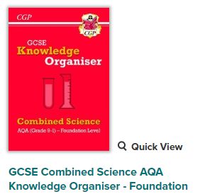
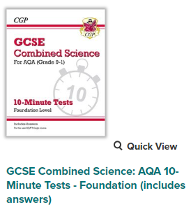
Raising Achievement in Science
2023
Tuesday, 12 March 2024
6. Revision guides provided by the school and ways to revise.
Pupil at HVS have two books that can use at home to revise:
Knowledge organiser
2. Retrieval practice 10min tests

Slide 30
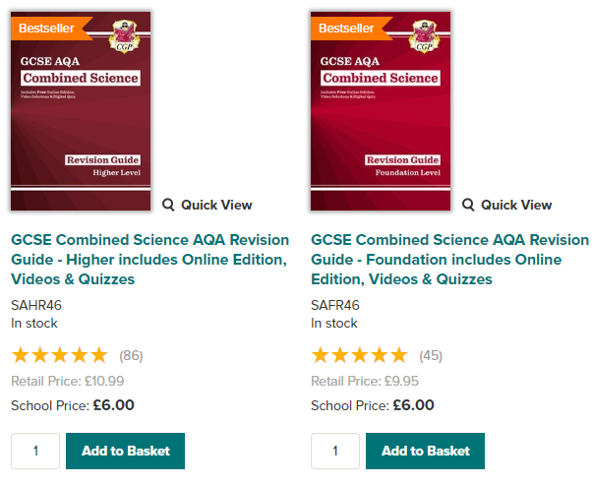
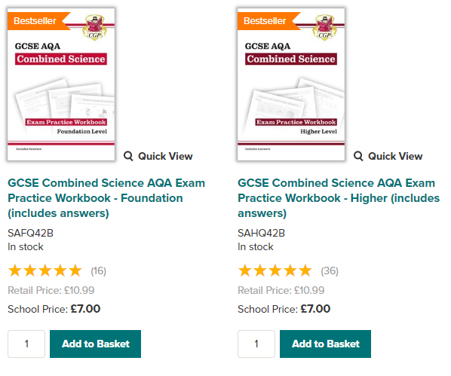
Raising Achievement in Science
2023
Tuesday, 12 March 2024
7. Revision guides recommended.

Slide 31
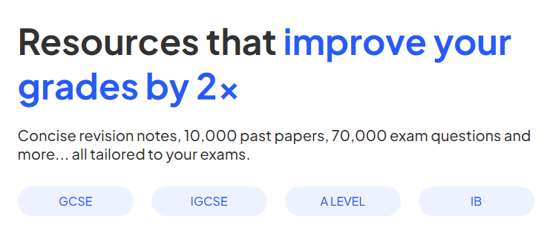
Raising Achievement in Science
2023
Tuesday, 12 March 2024
8. Websites for revision:
https://www.savemyexams.co.uk/
Username: leonteeutalia22@gmail.com
Password: Hopeviewschool (capital letter must be used)
https://www.footprints-science.co.uk/
No log in required
www.educake.co.uk
Individual logins are shared with each pupil

Slide 32
Raising Achievement in Science
2023
Tuesday, 12 March 2024
9. Practical videos for revision:
https://www.youtube.com/watch?v=CX2IYWggEBc
https://www.bbc.co.uk/bitesize/examspecs/zw488mn

Slide 33
Raising Achievement in Science
2023
Tuesday, 12 March 2024
The end!
If you have any questions, please email me on : eutalia.leonte@hopeviewschool.co.uk

Slide 34
Wednesday 13th March 2024
Digital Functional Skills qualification in ICT
Entry Level 3 and Level 1
 | Entry Level 3 | Level 1
Exam Board | Edexcel | Edexcel
Total Marks | 43 | 54
Duration | 90 Minutes | 105 Minutes
Skill Areas
1. Using devices and handling information
2. Creating and editing
3. Communicating
4. Transacting
5. Being safe and responsible online

Slide 35
Wednesday 13th March 2024
GCSE Computer Science
Exam Board : Edexcel
Length of the exam : Paper 1 (1 Hour 30 min) – Principles of computer science - written
Paper 2 (2 Hours) –Python Programming - Practical
Date of Exam : May/June
Total Marks : Paper 1 – 75 Marks
Paper 2 – 75 Marks
Revision : Computer Science textbook, Exam Practice workbook, Revision guides,
Knowledge organiser.

Slide 36
Wednesday 13th March 2024
The Duke of Edinburgh Award
A nationally recognised personal development award for young people aged 14-25.
Essential life skills | Builds confidence | Develops communication | Team-working

Slide 37
Wednesday 13th March 2024
Bronze
Over two years, students will aim to complete their bronze award at Hope View School.
Volunteering (3/6 Months) | Skills (3/6 Months) | Physical (3/6 Months) | Expedition
- Volunteering at lower site, supporting younger pupils with their work - Litter picking at Kingswood | - Learning a new skill. - Learn a language - Learn an instrument | - Taking part in a kind of physical activity - Playing a team sports | - Practice necessary skills, such as navigation, route planning, first aid and rucksack packing - Group expedition

Slide 38
Wednesday 13th March 2024
Bronze Expedition
Over two days, one night, the group will complete their expedition with minimal interactions with staff.
Each day students will undergo 6 hours (12KM) of planned activity, navigating to the pre planned checkpoints to meet the staff.
Student will need to demonstrate how to cook, set up tents and pack down equipment at the campsite.
Kit Lists will be sent out to parents in advanced.
Assessors (staff) will write reports following the expedition, Awards to be present at the end of year ceremony.

